Slide 1


FROM CRISIS TO STABILITY
TO POSSIBILITY

Slide 2
SOMETIMES A JOB ISN’T ENOUGH
Cuyahoga County families are working but still struggling to meet their basic needs
144,000
Households
CANNOT AFFORD THE BASICS
03

Slide 3
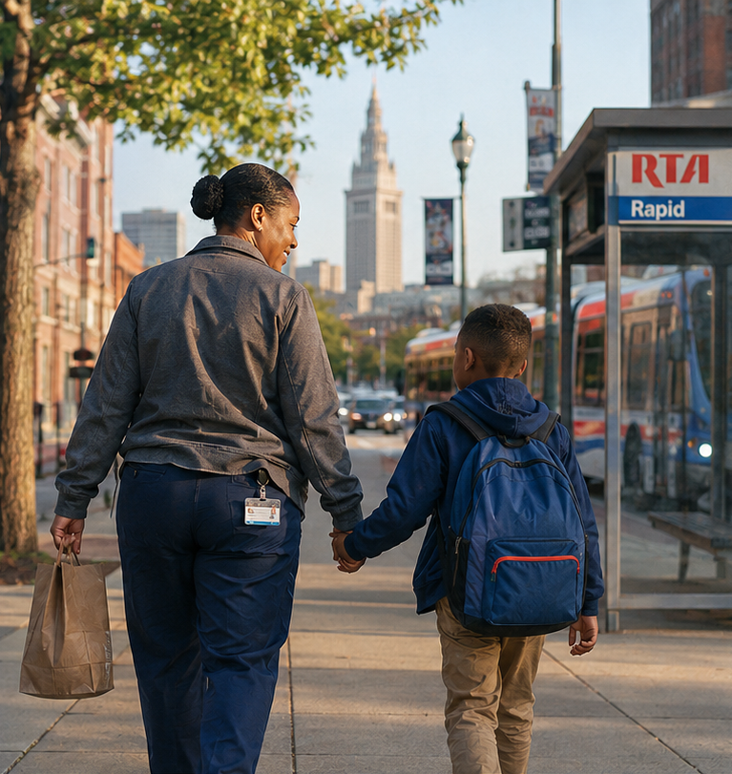
ALICE
Asset Limited
Income Constrained
Employed

Slide 4
UNITED WAY IS THE BRIDGE
Helping through crisis
Building stability
Opening doors to possibility
The issue is not whether people are working. It is upward mobility.

Slide 5
HOW UNITED WAY CREATES IMPACT
UNITED WAY 211
211 connects people to the right help at the right time.
INVESTMENTS & PARTNERSHIPS
THE BRIDGE FROM
CRISIS TO POSSIBILITY
Invests strategically to scale what works
EMPLOYER BASED SOLUTIONS
Supports employees through solutions like Bridges@Work
PUBLIC POLICY ADVOCACY
Creates change through partnership with lawmakers and policy influencers
07

Slide 6
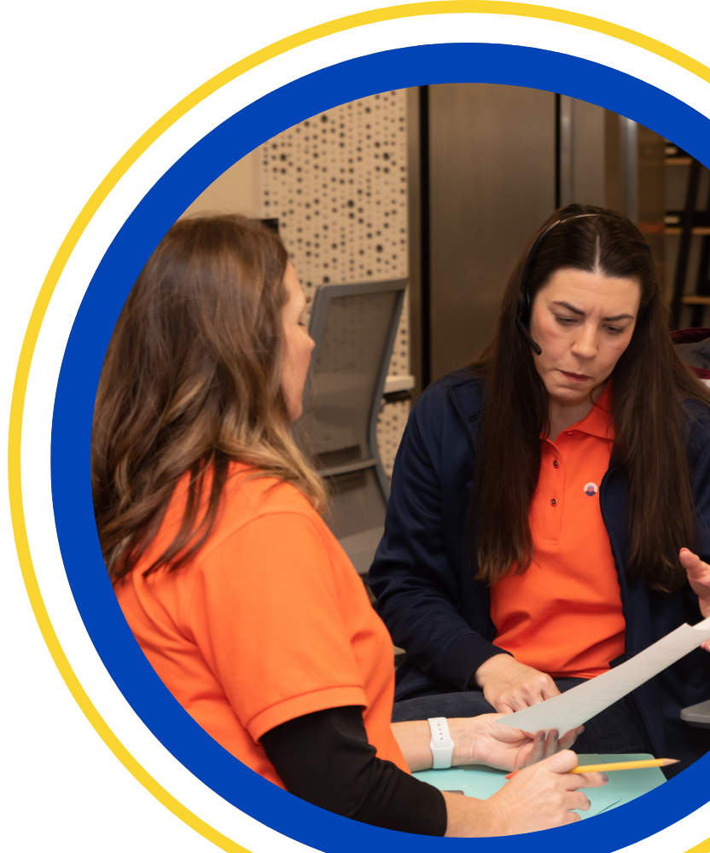
UNITED WAY 211
220,000+
calls for help answered
2 out of 3
of 211 callers are employed
$XX,XXX
Raised in 2025

Slide 7
INVESTMENTS & PARTNERSHIP
A coordinated response to Economic Mobility
Workforce
Childcare
Housing

Slide 8
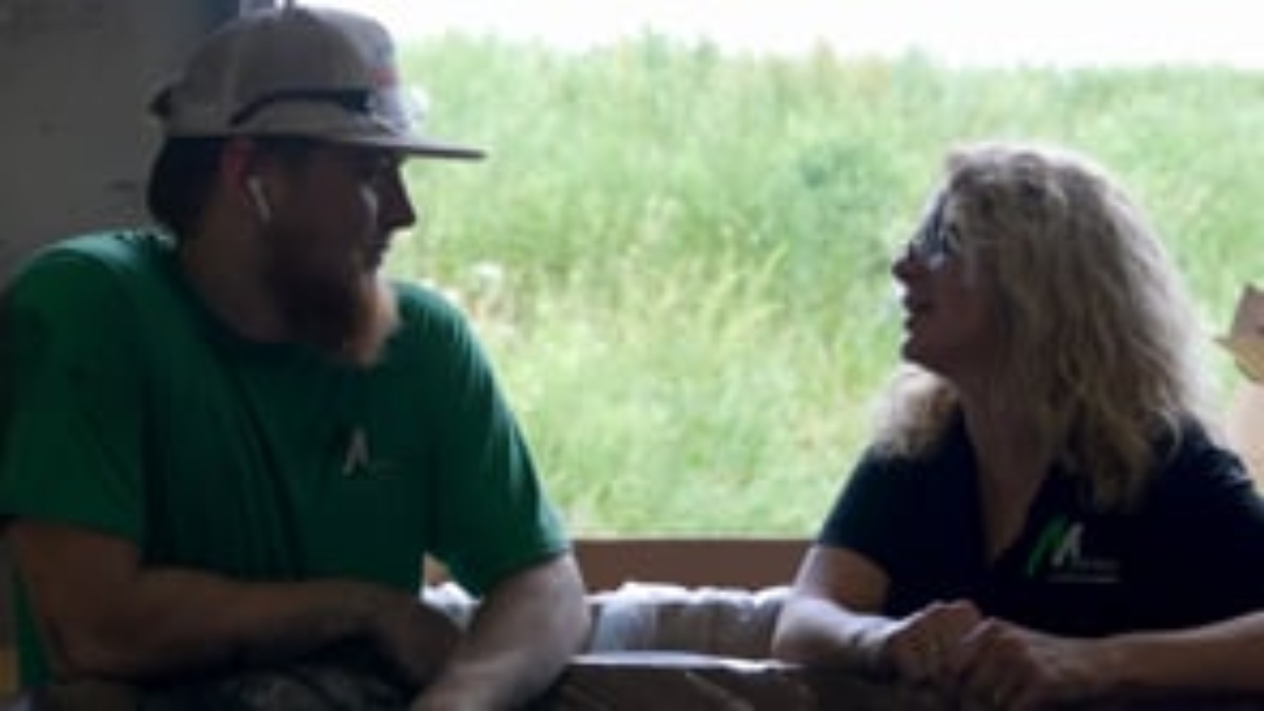
EMPLOYER-BASED SOLUTIONS
Bridges@Work

Slide 9
UNITED WAY IS THE BRIDGE FROM CRISIS TO POSSIBILITY
HELP ANYONE IN CRISIS
BUILD FINANCIAL STABILILTY
OPEN DOORS TO OPPORTUNITY
1
2
3
Provide the right help at
the right time.
Keep people from falling
into crisis.
Support people climbing toward financial security.
Making a Difference Together.
08

Slide 10


READY TO MAKE AN IMPACT?
Make your 2026 United Way pledge today!
Questions?
Erin Turner
eturner@unitedwaycleveland.org

